Slide 1

Food Delivery Operations
SQL Case Study
Operational Insights & Business Questions
Sonal Anand 24/08/2025

Slide 2

Project Overview
🚀 Food Delivery Operations — SQL Case Study Project
This case study simulates the challenges faced by food delivery platforms like Just Eat, Uber Eats and Deliveroo. Using a mock dataset of orders and couriers, I analysed delivery performance, customer experience and courier efficiency using advanced SQL.
Core SQL skills practised:
Each business question is tackled with a consistent process:
Translate the problem into clear SQL logic
Execute the query to extract key metrics
Distil findings into concise inferences
Aggregations & ratios
Date & time analysis
Business logic simulation
Conditional logic & outlier detection
Performance monitoring
Join logic & groupings

Slide 3

Approach & Methodology
Business Problem Define the operational or commercial question
SQL Query Write concise SQL to extract key metrics
Inference Summarise actionable insights & next steps
This structured approach mirrors real analytics workflows, ensuring each query is framed to answer a specific business problem and distilled into clear recommendations.

Slide 4
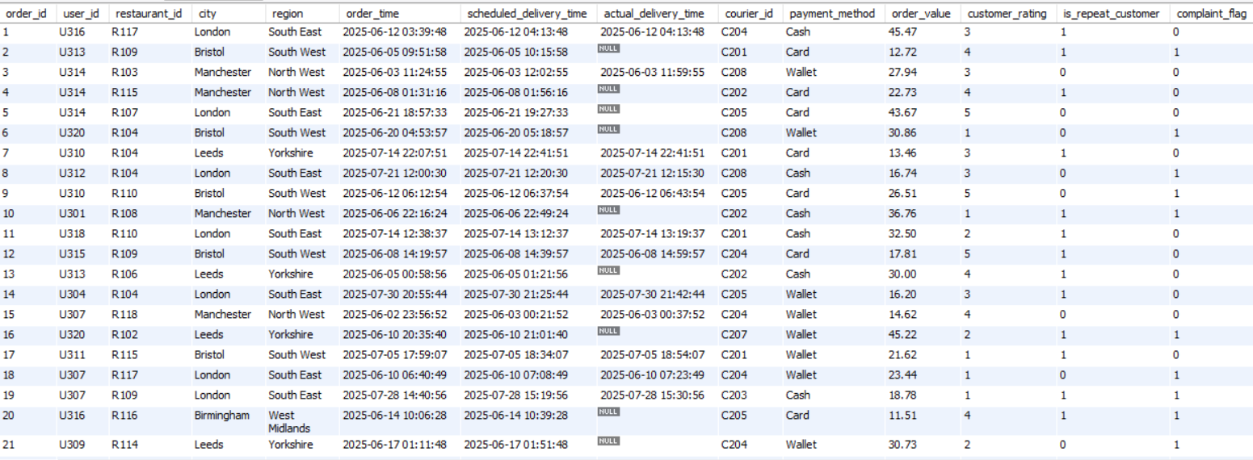
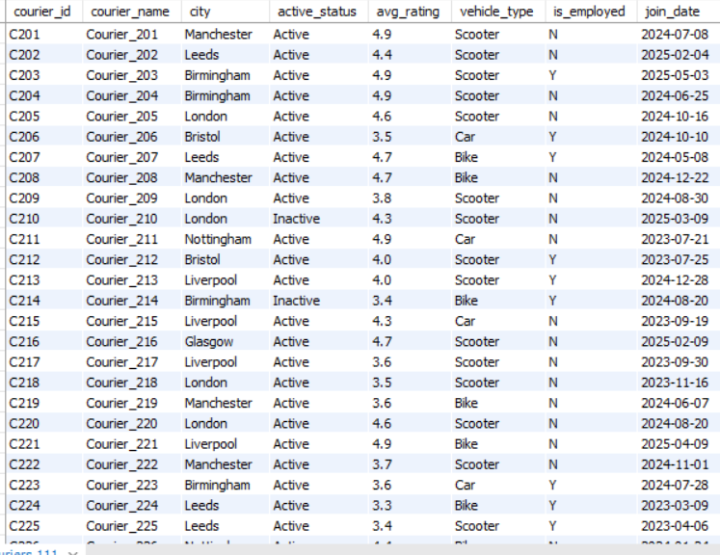
ORDERS table - 1
COURIERS table - 2

Slide 5
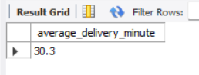
Q1: Average Delivery Time
Baseline efficiency & SLA benchmarking
SELECT ROUND(AVG(TIMESTAMPDIFF(MINUTE, order_time, scheduled_delivery_time)), 1) AS average_delivery_minute FROM orders;
Average delivery time: 30.3 minutes
The platform typically promises deliveries within ~30 minutes, forming a baseline SLA target.
Consistent overshoots could indicate prep, allocation or routing bottlenecks.
Investigate trends by region/time to identify improvement areas.

Slide 6
Q2: Which Courier Type is Fastest?
Optimise vehicle allocation by city
WITH cte1 AS (SELECT c.vehicle_type, AVG(TIMESTAMPDIFF(MINUTE, o.order_time, o.actual_delivery_time)) AS avg_delivery_time_in_minutes FROM couriers c JOIN orders o ON c.courier_id = o.courier_id GROUP BY c.vehicle_type)
SELECT vehicle_type, avg_delivery_time_in_minutes FROM cte1 WHERE avg_delivery_time_in_minutes = (SELECT MIN(avg_delivery_time_in_minutes) FROM cte1);
Fastest vehicle: Bike (28.5 mins)
Bikes are the most efficient, likely due to agility in dense traffic.
Cars and scooters are slower; allocate bikes to congested zones.
Use this insight to refine vehicle deployment strategies.

Slide 7

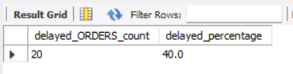
Q3: Delay Rate
Monitor and reduce order delays
SELECT COUNT(*) AS delayed_orders_count, ROUND(COUNT(*) * 100.0 / (SELECT COUNT(*) FROM orders), 1) AS delayed_percentage FROM orders WHERE actual_delivery_time > scheduled_delivery_time;
Delayed orders: 20 (40% of total)
40% delay rate is significant and should trigger SLA alerts.
Causes may include peak-hour surges, courier shortages, and restaurant prep delays.
Aim to reduce delays below 15% by addressing these bottlenecks.

Slide 8

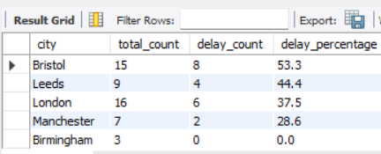
Q4: Top 5 Delay Cities
Identify problem zones
WITH total_cte AS ( SELECT city, COUNT(*) AS total_count FROM orders
GROUP BY city),
delayed_cte AS ( SELECT city,COUNT(*) AS delay_count
FROM orders
WHERE actual_delivery_time IS NOT NULL
AND actual_delivery_time > scheduled_delivery_time GROUP BY city)
SELECT t.city,
t.total_count,
COALESCE(delay_count, 0) AS delay_count, ROUND(COALESCE(d.delay_count, 0) * 100.0 / t.total_count, 1) AS delay_percentage
FROM total_cte t
LEFT JOIN delayed_cte d
ON t.city = d.city
ORDER BY delay_percentage DESC
LIMIT 5;
Bristol tops the list with a 53.3% delay rate, followed by Leeds (44.4%) and London (37.5%).
These cities should be prioritised for deep dives into courier allocation, prep times and traffic patterns.
Birmingham appears delay-free but has a low sample size; additional data is needed.

Slide 9

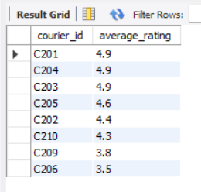
Q5: Avg Ratings of Couriers with Delays
Assess whether ratings reflect punctuality
SELECT DISTINCT o.courier_id,
c.avg_rating AS average_rating FROM orders o JOIN couriers c ON o.courier_id = c.courier_id WHERE actual_delivery_time IS NOT NULL AND actual_delivery_time > scheduled_delivery_time ORDER BY average_rating DESC;
High‑rated couriers like C201, C203 and C204 still delivered delayed orders.
Customer ratings may emphasise friendliness or food condition over timeliness.
Consider incorporating on‑time rate into courier performance evaluations.

Slide 10

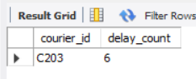
Q6: Couriers Late > 3 Times
Flag persistent lateness for review
SELECT courier_id,
COUNT(*) AS delay_count FROM orders WHERE actual_delivery_time IS NOT NULL AND actual_delivery_time > scheduled_delivery_time GROUP BY courier_id HAVING COUNT(*) > 3;
Courier C203 – 6 delayed deliveries
C203 breaches the 3‑delay threshold, signalling a performance issue.
Integrate automatic flags into HR or ops dashboards for proactive intervention.
Consider retraining, reassignment or feedback to address route complexity or workload.

Slide 11

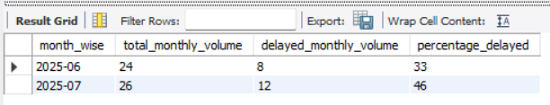
Q7: Monthly Volume & Delays
Detect seasonal pressure or dips
WITH total_order_cte AS ( SELECT DATE_FORMAT(order_time, "%Y-%m") AS month_wise, COUNT(*) AS total_monthly_volume FROM orders GROUP BY DATE_FORMAT(order_time, "%Y-%m") ), delayed_delivery_cte AS ( SELECT DATE_FORMAT(order_time, "%Y-%m") AS month_wise, COUNT(*) AS delayed_monthly_count FROM orders WHERE actual_delivery_time IS NOT NULL AND actual_delivery_time > scheduled_delivery_time GROUP BY DATE_FORMAT(order_time, "%Y-%m") ) SELECT t.month_wise, t.total_monthly_volume, d.delayed_monthly_count, ROUND(d.delayed_monthly_count * 100.0 / t.total_monthly_volume, 2) AS percentage_delayed FROM total_order_cte t JOIN delayed_delivery_cte d ON t.month_wise = d.month_wise;
June saw 24 orders with 33% delays, while July increased to 26 orders with 46% delays.
The seasonal spike in July suggests proactive scheduling and capacity planning are needed.

Slide 12

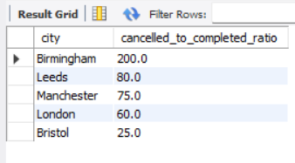
Q8: Cancellation vs Completion Ratio
Reduce cancellations by city
SELECT city, ROUND(SUM(CASE WHEN actual_delivery_time IS NULL THEN 1 ELSE 0 END) * 100.0 / SUM(CASE WHEN actual_delivery_time IS NOT NULL THEN 1 ELSE 0 END), 1) AS cancelled_to_completed_ratio FROM orders GROUP BY city ORDER BY cancelled_to_completed_ratio DESC;
Birmingham, Leeds and Manchester have alarmingly high cancellation ratios (>75%), with Birmingham at 200%.
Investigate whether couriers are declining jobs, restaurants cancel due to prep delays, or payment drop‑offs occur.
Bristol is relatively stable at 25%, but continuous monitoring is necessary.

Slide 13

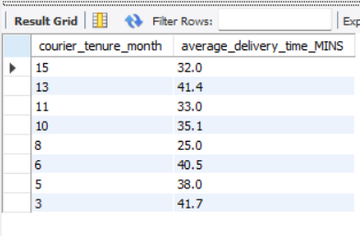
Q9: Delivery Time by Tenure
Assess experience vs performance
SELECT TIMESTAMPDIFF(MONTH, c.join_date, NOW()) AS courier_tenure_month, ROUND(AVG(TIMESTAMPDIFF(MINUTE, o.order_time, o.actual_delivery_time)), 1) AS average_delivery_time_MINS FROM couriers c JOIN orders o
ON c.courier_id = o.courier_id GROUP BY courier_tenure_month ORDER BY courier_tenure_month DESC;
No clear linear correlation: 7‑month tenure couriers are fastest (25 mins), but 12‑ and 3‑month tenures are among the slowest.
Performance may depend more on city assignment, vehicle type or route density than tenure alone.

Slide 14

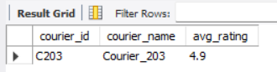
Q10: Ratings vs Frequent Lateness
Examine rating reliability
Courier C203 – Rating 4.9 despite frequent lateness
-- Simulate frequently_late flag using delayed counts > 3
WITH late_count AS ( SELECT courier_id, COUNT(*) AS delayed_count FROM orders WHERE actual_delivery_time IS NOT NULL
AND actual_delivery_time > scheduled_delivery_time GROUP BY courier_id HAVING COUNT(*) > 3 ) SELECT c.courier_id, c.avg_rating FROM couriers c
JOIN late_count l
ON c.courier_id = l.courier_id WHERE c.avg_rating > 4.5;
High rating despite frequent lateness questions the reliability of current rating systems.
Customers may rate based on friendliness or food condition rather than punctuality.
Operational metrics like on‑time delivery should accompany ratings for a balanced score.

Slide 15

Conclusion & Next Steps
Average promised delivery is ~30 mins; 40% of orders are late.
Bikes outperform other vehicles; Bristol, Leeds & London suffer highest delays.
High ratings don’t guarantee punctuality; C203 flagged despite 4.9 rating.
Seasonal and regional patterns reveal spikes in delays and cancellations.
Courier tenure isn’t strongly correlated with delivery speed.
Prioritise operational reviews in high-delay cities and high-cancellation zones.
Optimise vehicle allocation: deploy more bikes in dense areas.
Incorporate on-time rate into courier scoring systems.
Build dashboards to flag frequent lateness and seasonal spikes automatically.
Cross-analyse with city assignment, vehicle type and route density to uncover true drivers.

